Slide 1
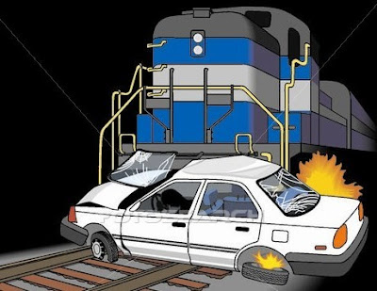
US Highway RailRoad Crossing Accident
DATS 6103 PROJECT
Team 3 Members:
Aakash Hariharan
Abhilasha Singh
Trisha Singh
Vishal Fulsundar

Slide 2
Overview
Smart questions
Data Overview
Data Visualization
Addressing SMART Questions Using Data Visualizations and Predictive Models

Slide 3
Smart Questions
How can we predict the severity of a driver's injury in a railroad crossing accident using external factors?
01
How can we identify accident-prone locations in USA based on accident frequency over the past 46 years?
02
How can we predict the location of crossing warning sign present during railroad accidents, based on the historical data.
03

Slide 4
Dataset Details
US Highway Railroad Crossing Accident dataset sourced from Kaggle
Dataset contains,
120365 observations
46 variables
Railroad Information, Incident Details, Location Information, Highway and Crossing Details, Vehicle Information, Train Information, Environmental Conditions

Slide 5
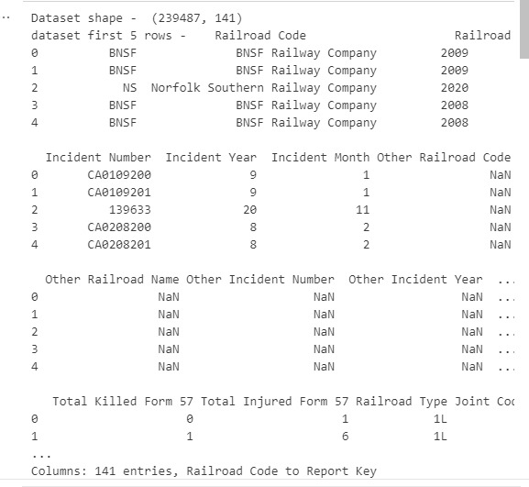

Preprocessing Overview
Insights:
Removed missing values
Dropped Correlated Columns
Duplicate values
Outliers
Label Encoder

Slide 6
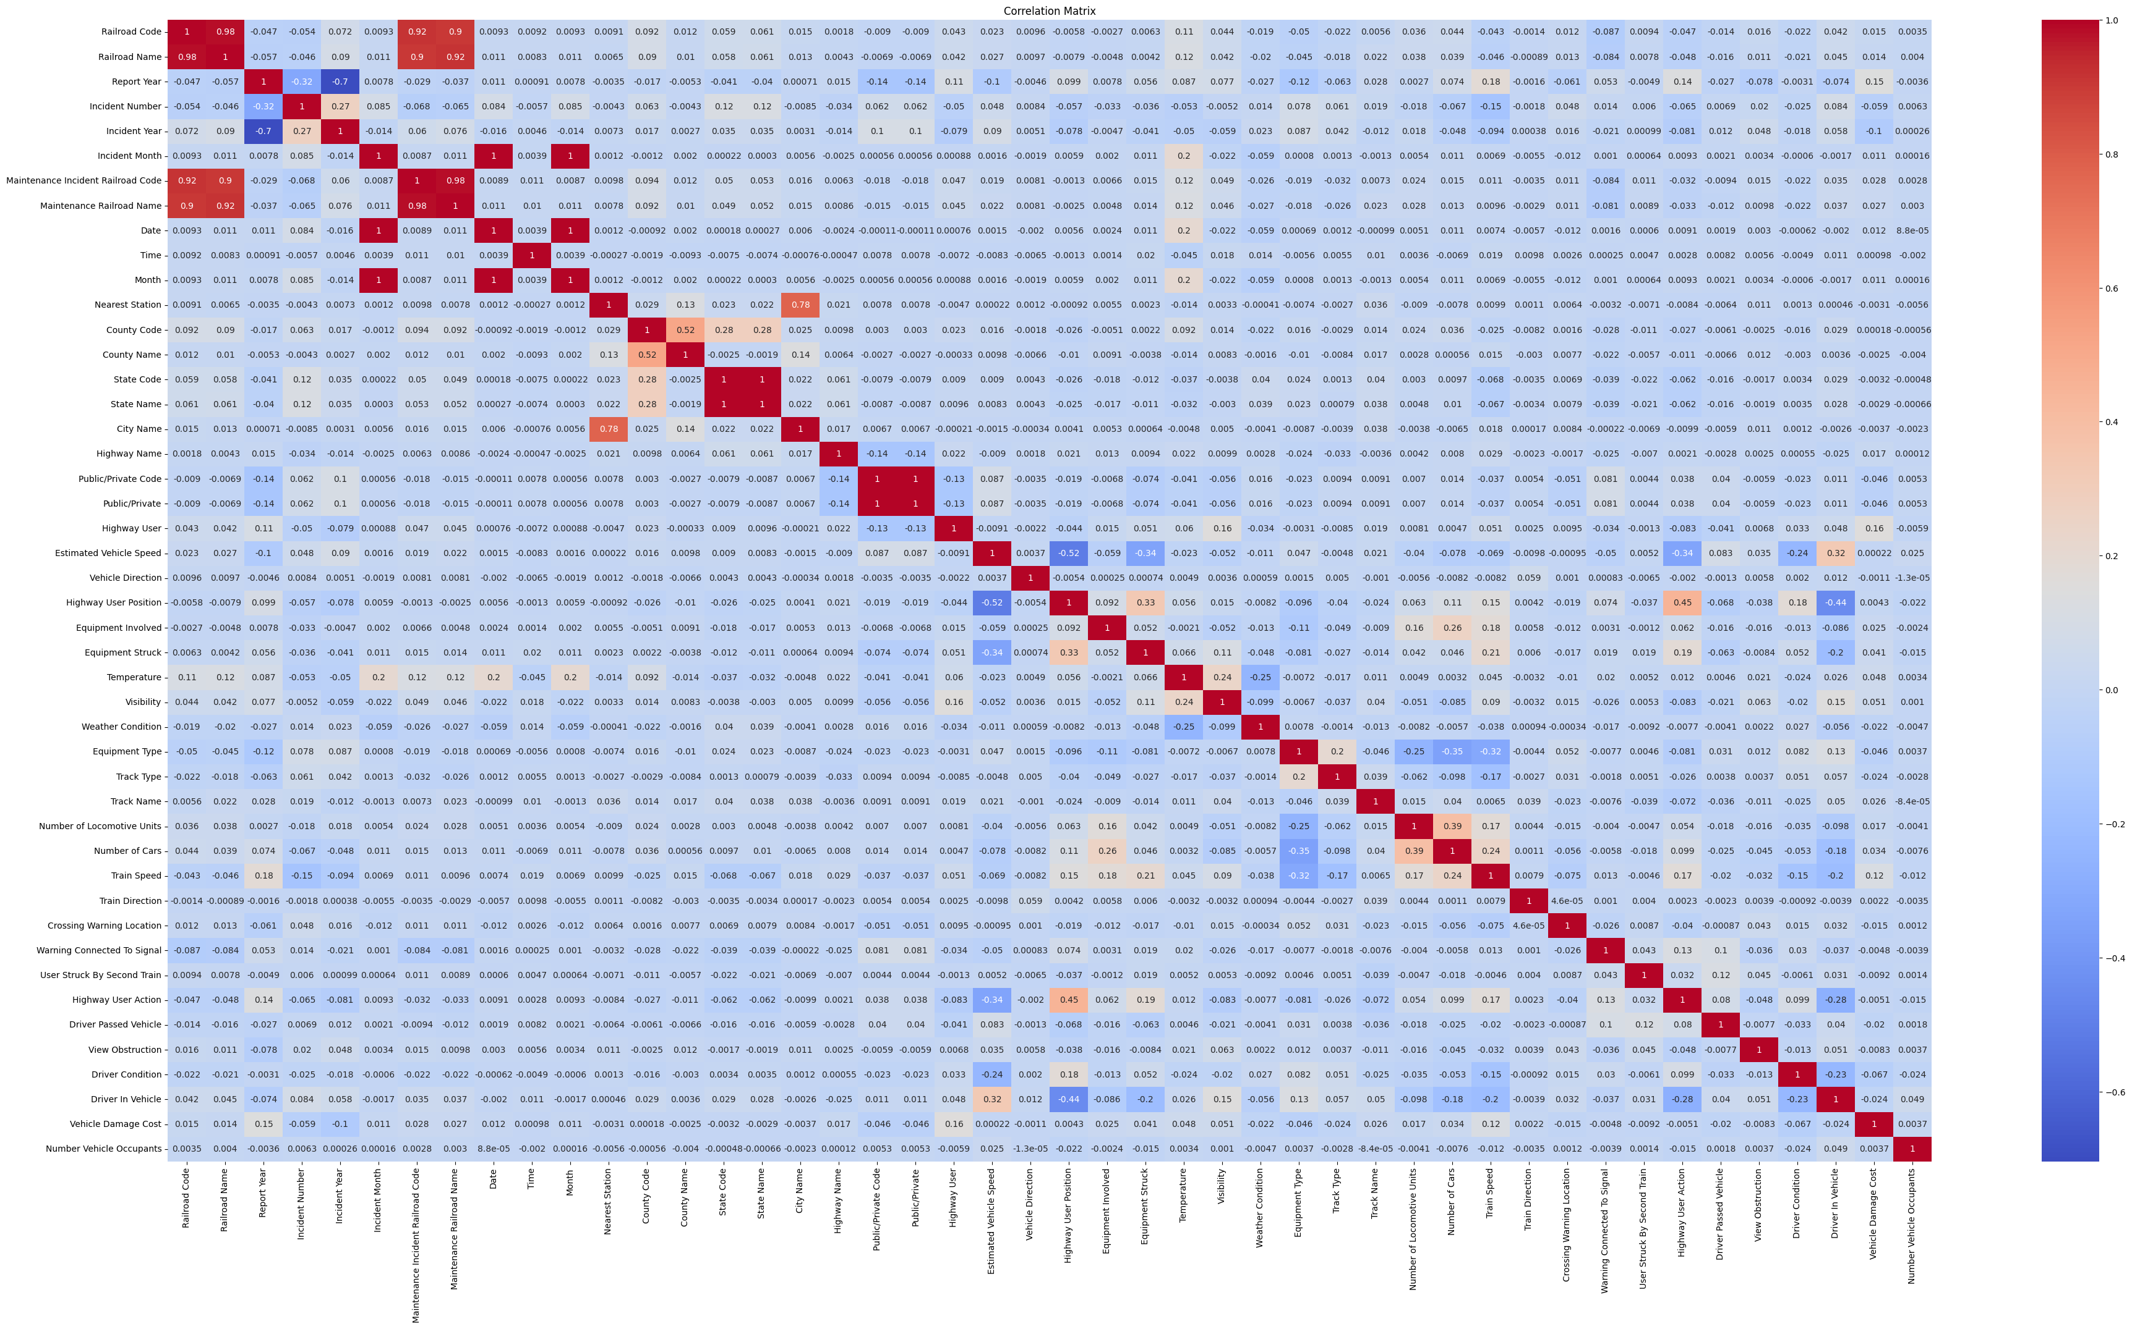
Data Visualization
Correlation Matrix
Insights:
Year, Month, State, Weather, Train Speed, Highway user position are some of all the variables which are correlated

Slide 7
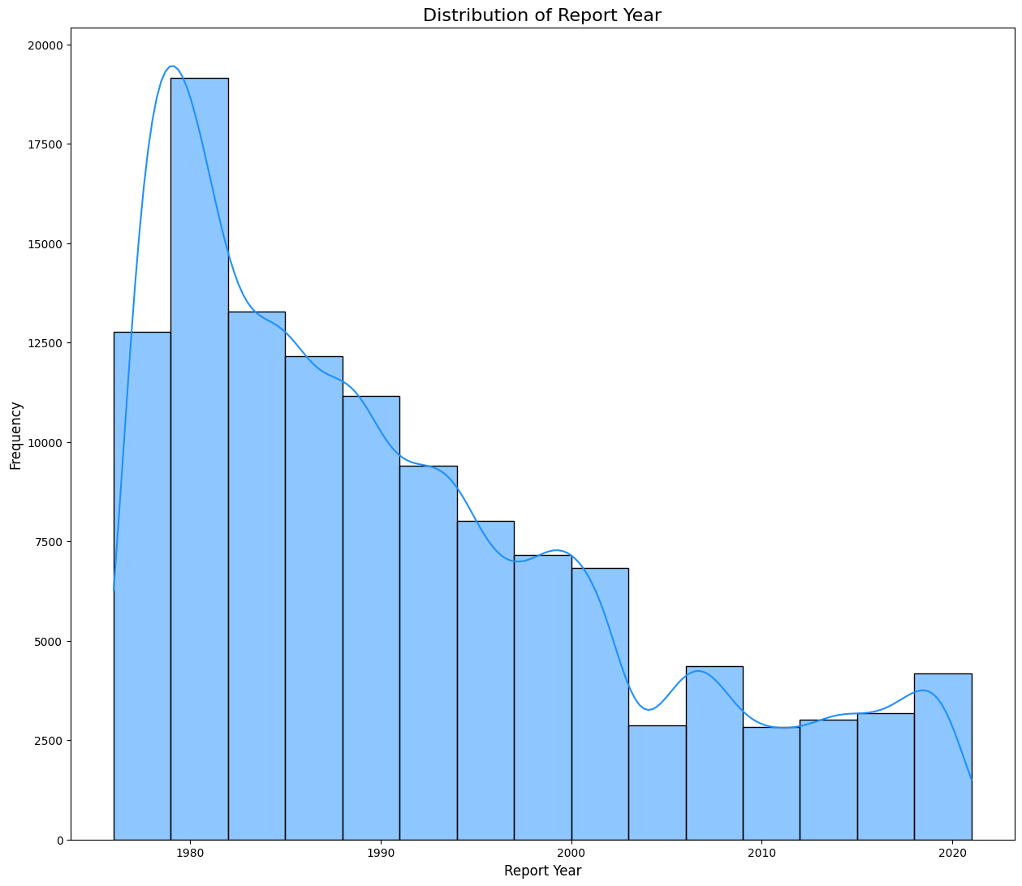
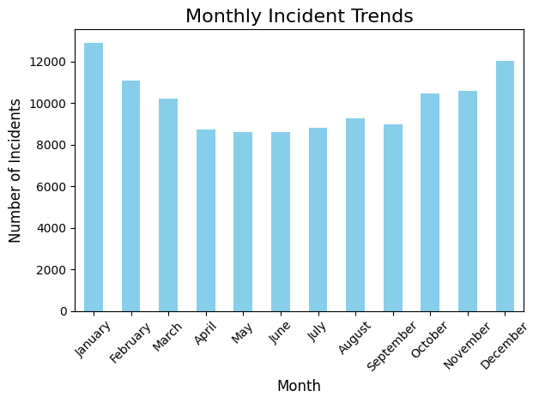
Data Visualization
YEAR: 1980, the incident count was significantly higher, but over the years, there has been a sharp decline in the number of incidents
MONTH : January and December show the highest number of incidents, while April, May, and June experience a small drop of around 3,000 incidents

Slide 8
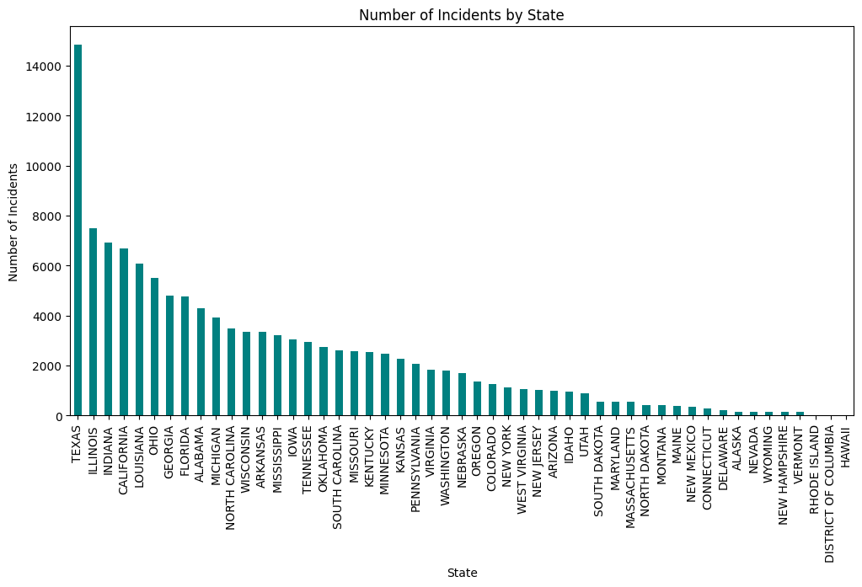
Data Visualization
STATE : Texas has the significantly highest number of incidents, followed by Illinois, Indiana. In contrast, Hawaii and District of Columbia has almost no incidents.

Slide 9
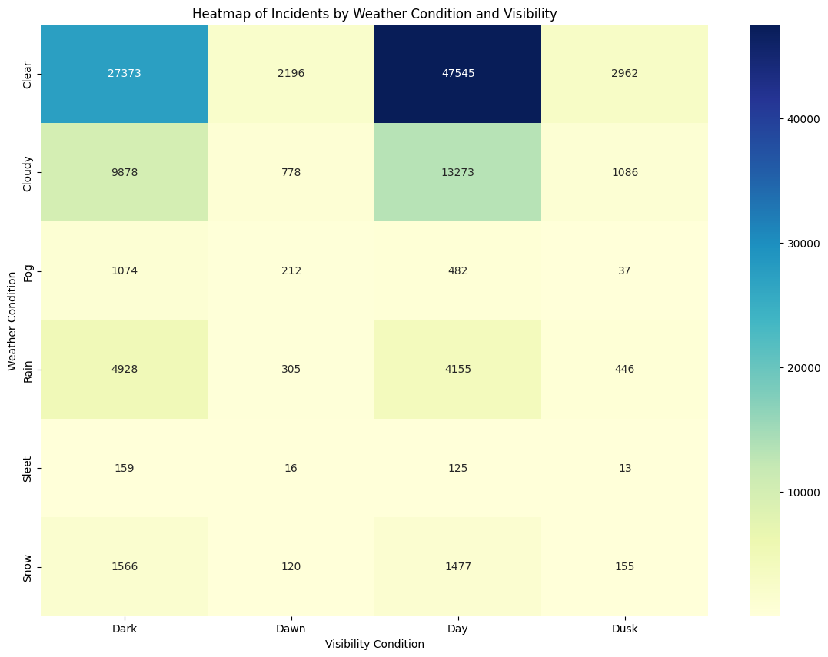
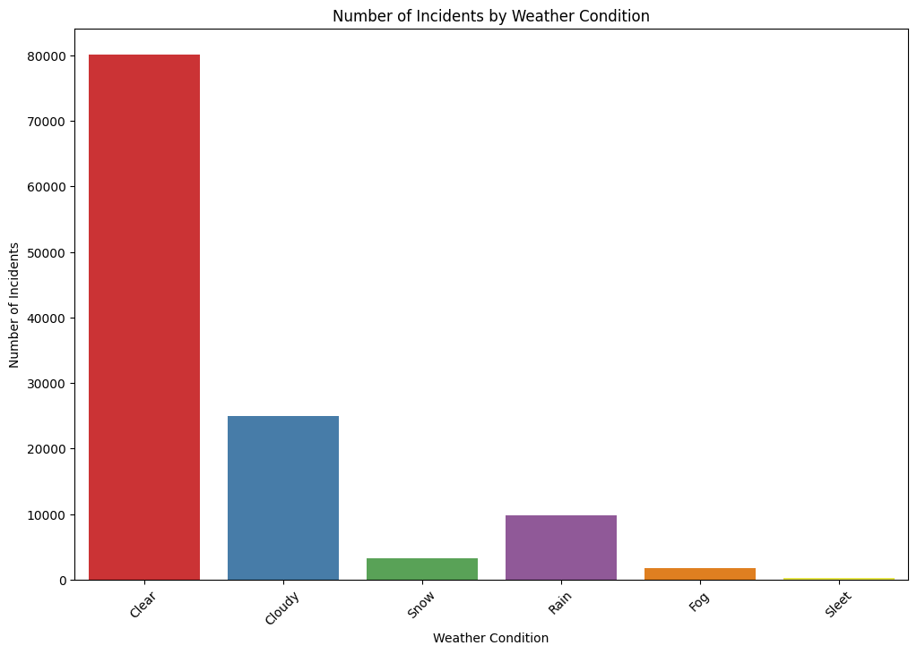
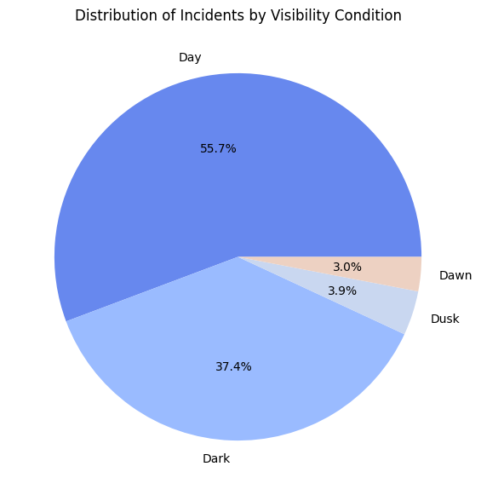
Data Visualization
WEATHER AND VISIBILITY : Clear weather is linked to a significant number of incidents. Additionally, when examining the visibility graph, we observe that 50% of incidents occur during daylight hours, followed by 38% during nighttime.

Slide 10
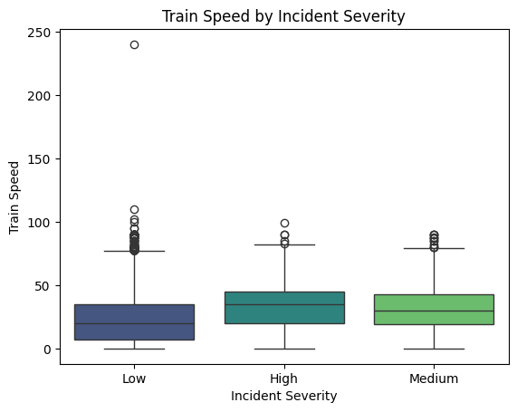
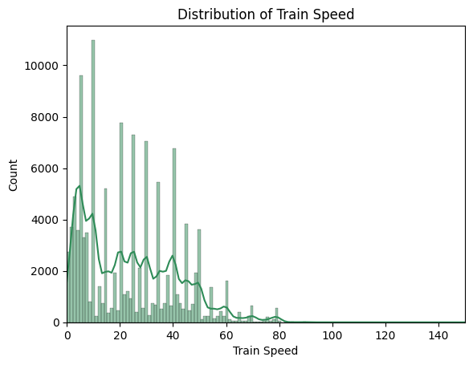
Data Visualization
TRAIN SPEED : Trains traveling at speeds below 50 account for the highest number of incidents. While incident severity shows minimal variation overall, higher-speed trains tend to be associated with more severe incidents.

Slide 11
SMART QUESTION
1. How can we predict the severity of a driver's injury in a railroad crossing accident using external factors?

Slide 12
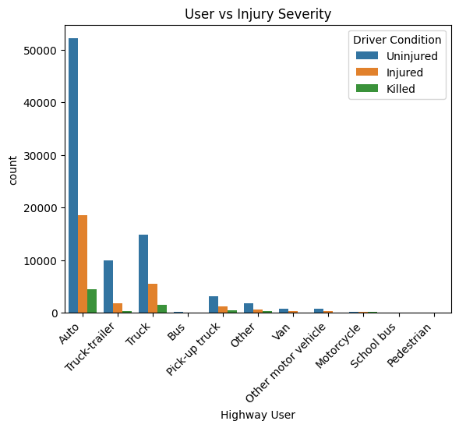
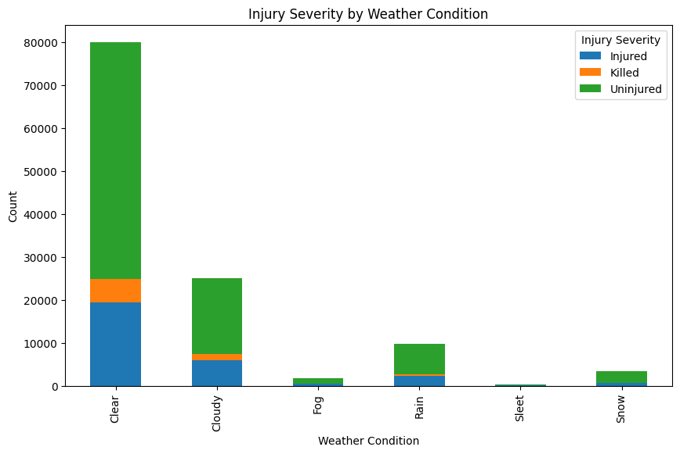
Exploratory Data Analysis

Slide 13
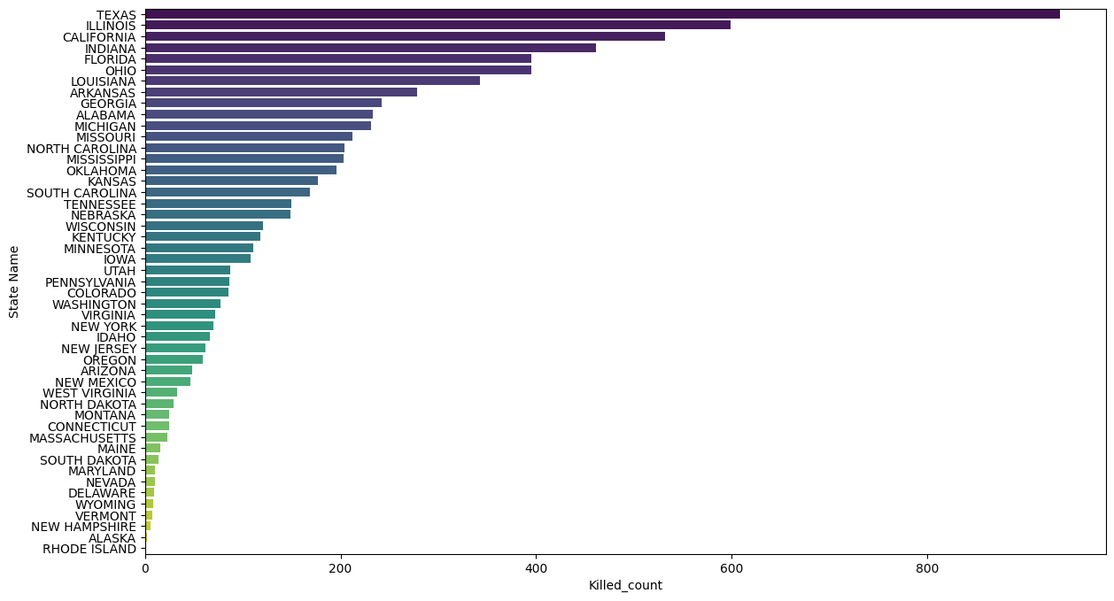
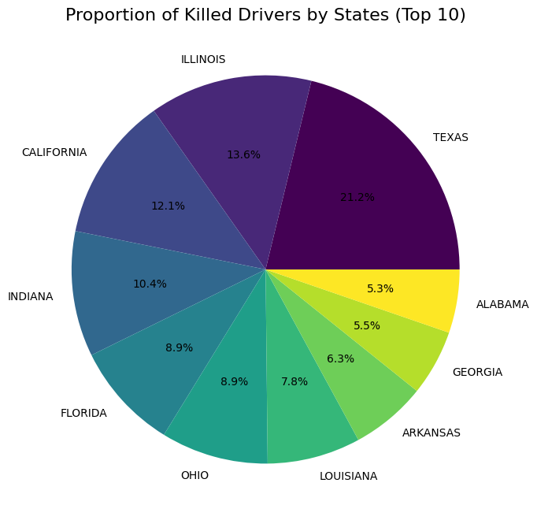
Exploratory Data Analysis

Slide 14
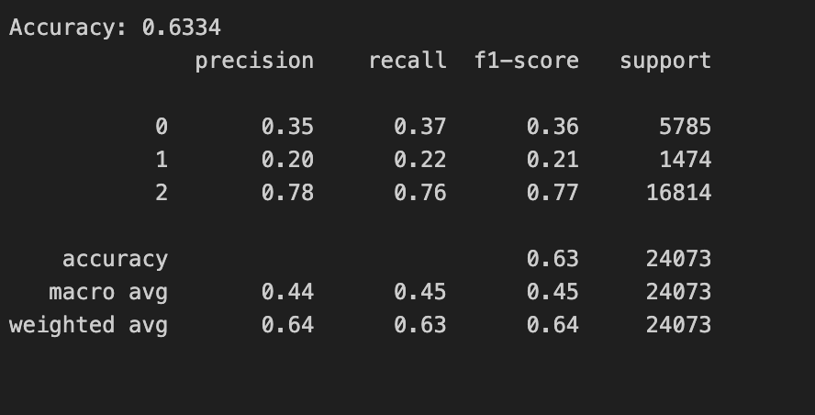
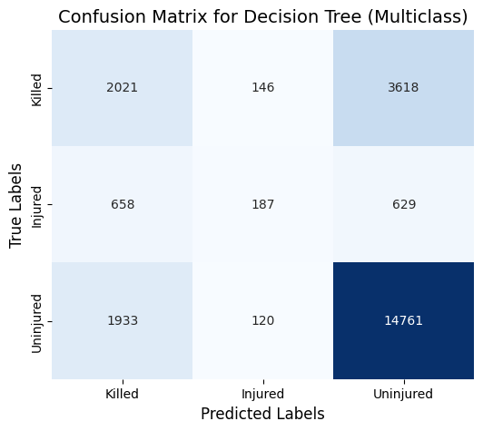
MODEL 1 – DECISION TREES
The accuracy is low
Model Performance is mediocre

Slide 15



Hyperparameter Tuning
Params | Values | Interpretation
Max_depth | [3, 5, 7, 10, None] | Limits how deep the tree can grow to prevent overfitting
Min_samples_split | [2, 5, 10] | The minimum number of samples required to split a node
Min_samples_leaf | [1, 2, 4] | The minimum number of samples that a leaf node must contain
Max_features | ['sqrt', 'log2', None] | The number of features to consider when looking for the best split

Slide 16
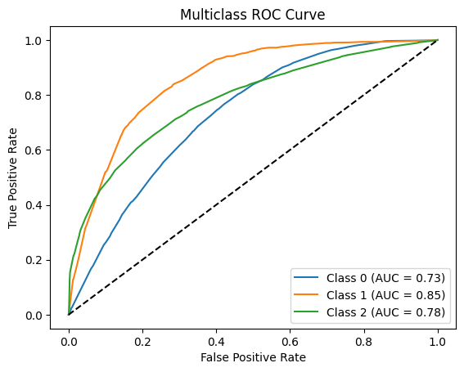
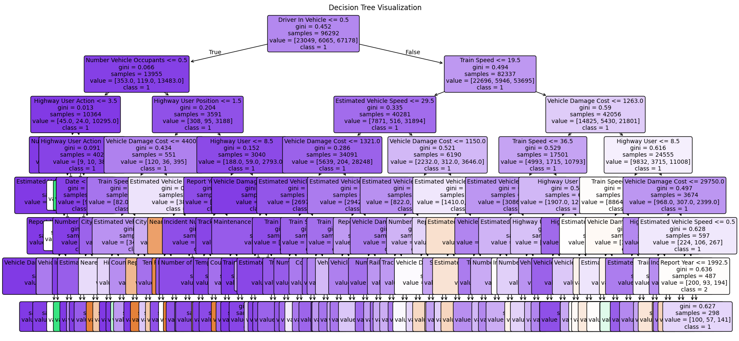
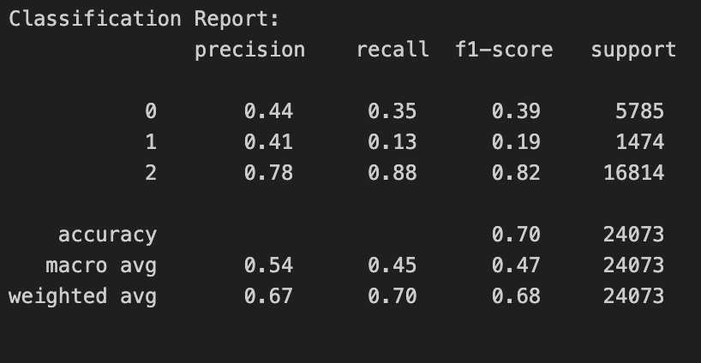
Results

Slide 17
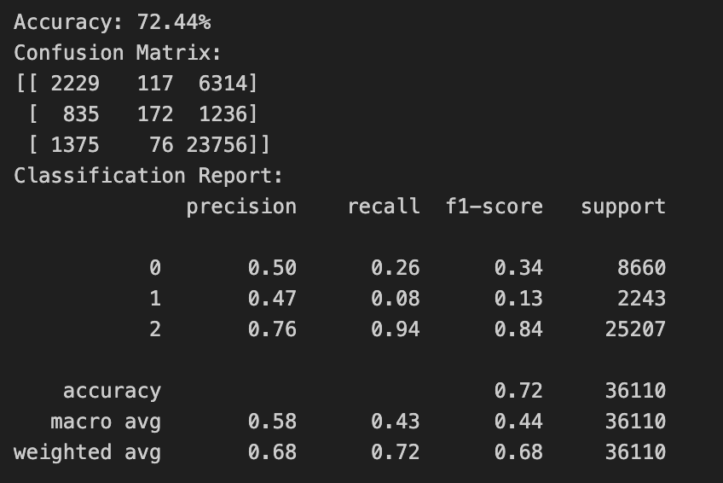
Model 2 – Random Forest
Class 2 has the best performance, with high precision, recall, and F1-score, indicating that the model is very good at identifying class 2 instances. Slight overfit occurring on Class 1 and 0.

Slide 18
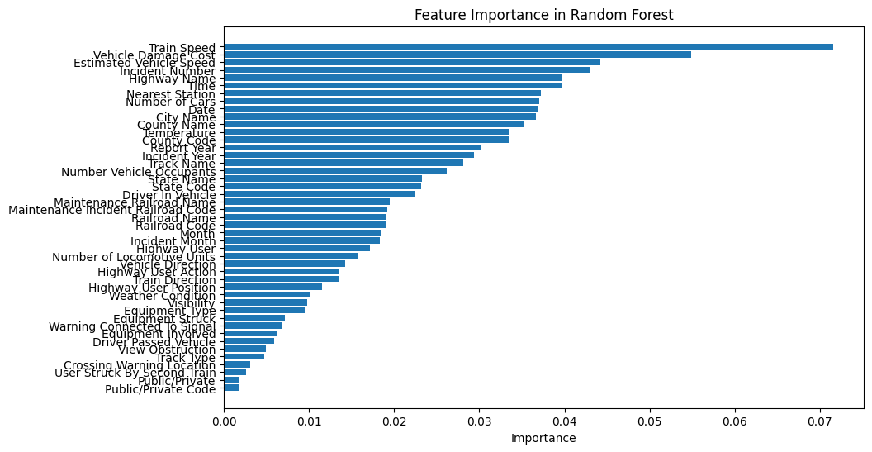
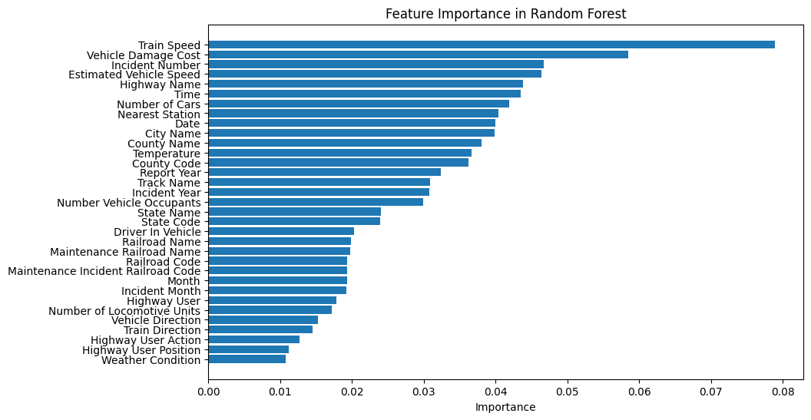
Feature Selection

Slide 19
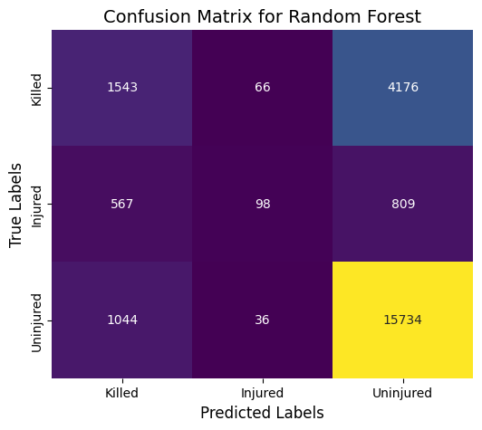
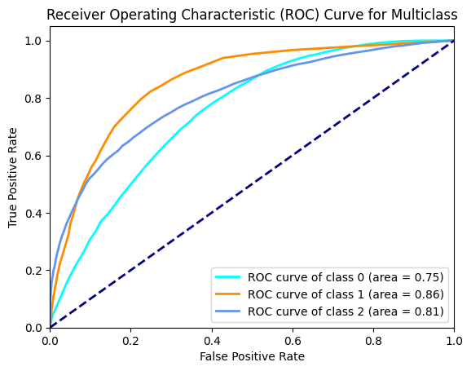
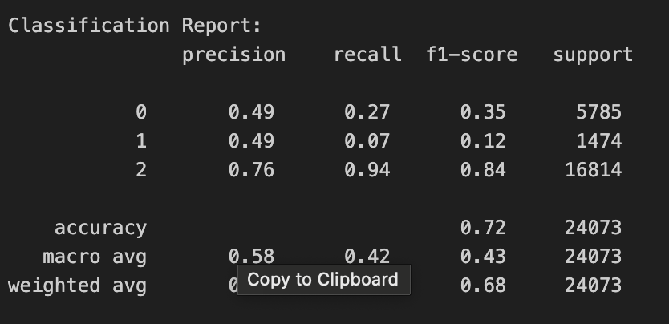
Results
Even after removing the low importance features, there is not any significant change in the evaluation metrics of the model. But the overall performance and speed is much better.
Random Forest is still performing better than the Decision Tree Model.

Slide 20
SMART QUESTION
2. How can we identify accident-prone locations in USA based on accident frequency over the past 46 years?

Slide 21
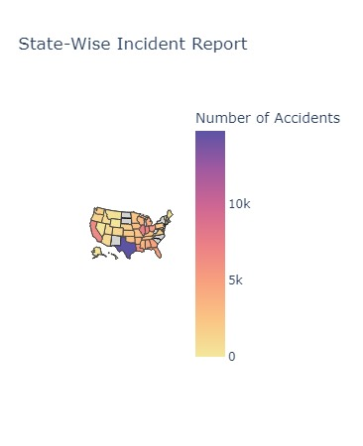
Exploratory Data Analysis
Insights : State-wise incident count in US. Texas has the highest incident counts
While Hawaii and DC has no incident count.

Slide 22
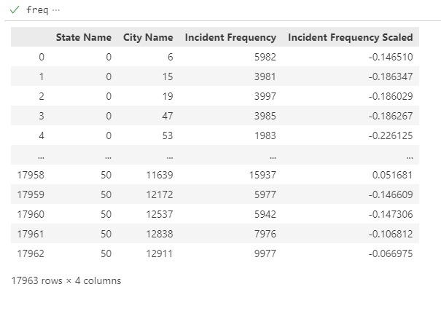
Data Scaling
Insights :
After scaling data, we got the frequency of incident.

Slide 23
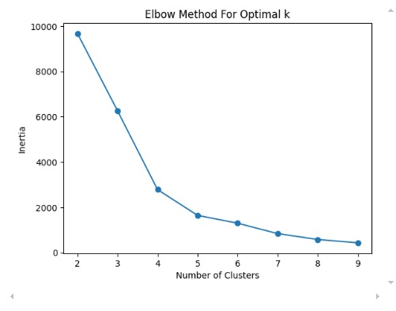
Modeling
Insights :
Used Elbow method to find the optimal number of clusters
4 clusters were found.
Elbow method- compute the within cluster sum of square and no of cluster

Slide 24
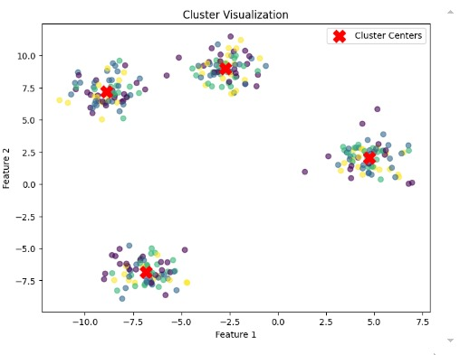
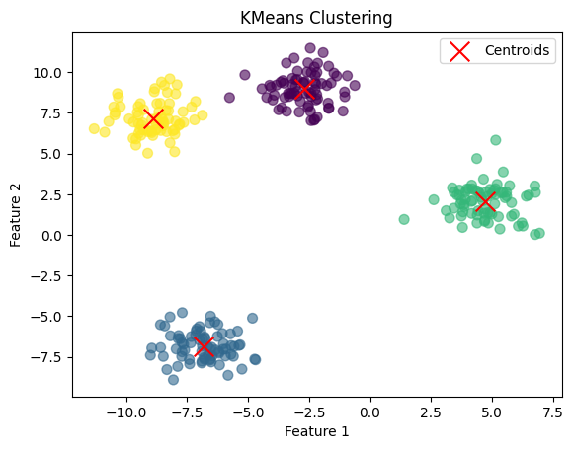
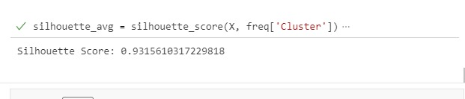
Modeling
Insights :
Training Data
Testing Data

Slide 25
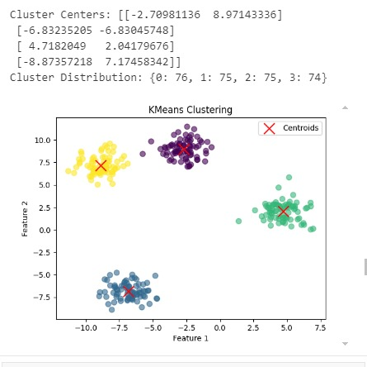

Modeling
Insights :
For zero cluster represent small state and big city.
For cluster one both city and state are small
For cluster two both city and state are large
For cluster three its outliers.

Slide 26
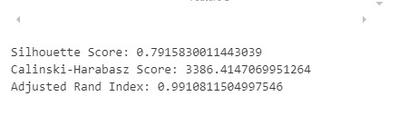
Results
Interpretation :
Silhouette score is 0.7916 meaning cluster are well defined and points are close to their own cluster centroids.
Adjusted Rand Index is 0.991 meaning cluster assign extremely well with true label.
Calinski score meaning better defined cluster.

Slide 27
SMART QUESTION
3. How can we predict the location of crossing warning sign present during railroad accidents, based on the historical data.

Slide 28
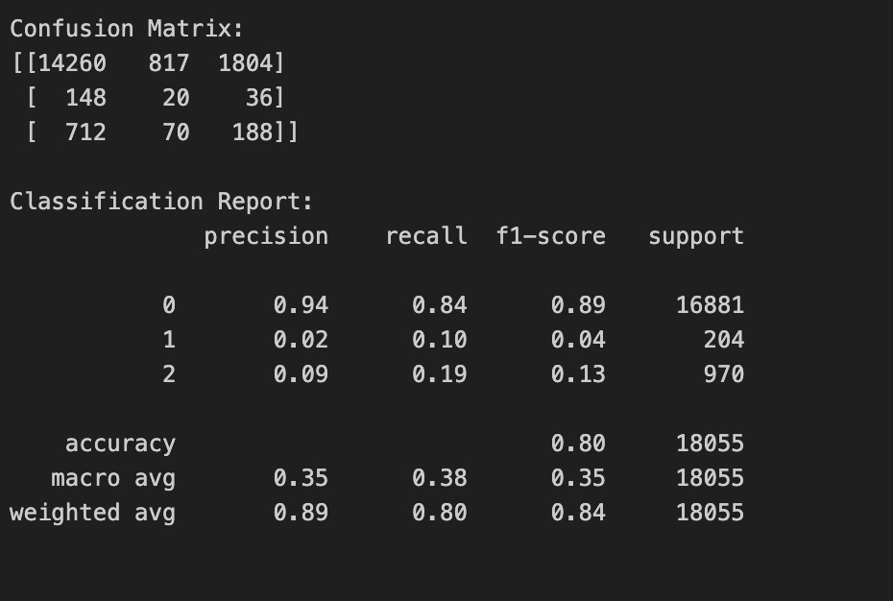
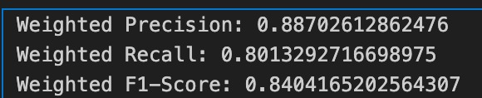
Modeling
Insights :
The model performs well on Class 0, with high true positives.
Performance on Classes 1 and 2 is poor due to imbalanced data or insufficient patterns learned for these classes.

Slide 29
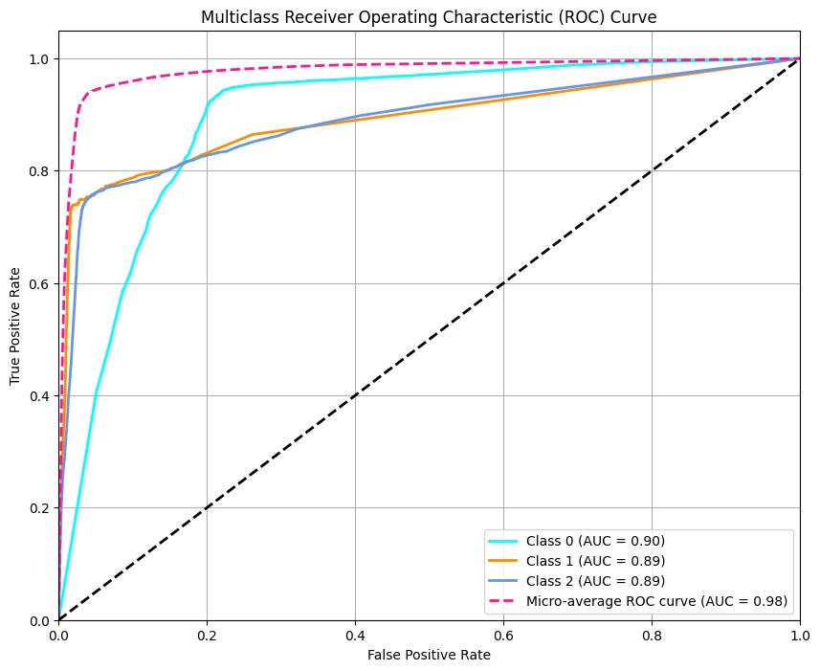
Result
Insights :
AUC is more than 0.7 which is a good model
The model distinguishes well between the classes (high AUC values for all).
• The micro-average AUC (0.98) reflects excellent overall classification performance.

Slide 30

Any thoughts or questions?

